Slide 1


Seamless Smart Home Integration with ESP32 & Blynk"
Team number :11

Slide 2
Team Members | Registration Number
P.Shruthi | 2310040061
M. Ravi Teja | 23100400701
S. Vaishnavi | 2310040081
A. Gouthami | 2310040092

Slide 3
ABSTRACT:
Smart home automation using Blynk and ESP32 leverages IoT technology to provide efficient, remote, and real-time control of household appliances. The integration of Wi-Fi connectivity enables seamless communication between the ESP32 microcontroller and the Blynk mobile application, allowing users to monitor and manage devices from anywhere. This system enhances convenience, energy efficiency, and security by automating appliances based on predefined conditions and user commands. Additionally, the ability to send real-time notifications and collect data further improves the intelligence of the system.
A key feature of this automation setup is its dual control mechanism, which includes both Wi-Fi-based remote operation and manual switching. The manual mode ensures continued functionality even in the absence of an internet connection, thereby increasing the system’s reliability

Slide 4
LITERATURE SURVEY:
Introduction:
Home automation refers to the use of technology to control household appliances and systems, enhancing convenience, security, and energy efficiency. With advancements in the Internet of Things (IoT), smart home automation has become more accessible and efficient. The ability to control and monitor devices remotely offers significant advantages, such as energy savings and improved home security. Various technologies, including microcontrollers, cloud platforms, and wireless communication protocols, have enabled the seamless operation of home automation systems
Existing Technologies and Methods:
Smart home automation using Blynk and ESP32 integrates both Wi-Fi and manual control methods to enhance flexibility and convenience. The ESP32, a powerful microcontroller with built-in Wi-Fi, connects to the Blynk IoT platform, allowing users to remotely monitor and control home appliances via a smartphone app. Through Wi-Fi, commands can be sent to the ESP32, enabling automation features such as scheduling, real-time monitoring, and voice control. Additionally, manual control is implemented using physical switches or push buttons, ensuring functionality even when the internet is unavailable. This dual-mode approach enhances reliability and user control, making smart home systems more efficient and adaptable.

Slide 5
Prior Research and Theoretical Background:
Prior research on smart home automation using IoT highlights the integration of microcontrollers like ESP32 with cloud-based platforms such as Blynk for remote monitoring and control. Theoretical foundations are based on embedded systems, wireless communication, and automation principles, leveraging protocols like MQTT and HTTP for data transmission. Studies have explored the efficiency of Wi-Fi-enabled IoT devices in reducing energy consumption and enhancing security. Additionally, research on hybrid control methods emphasizes the importance of manual override mechanisms for reliability. Theoretical models in sensor networks, real-time processing, and mobile app-based interaction provide the groundwork for designing efficient and scalable home automation systems.
Research Gaps and Project Relevance:
While existing radar and object detection systems are effective, they often rely on expensive hardware or complex setups, making them impractical for low-cost, real-time applications. There is limited research on integrating radar with computer
vision using low-cost microcontrollers like ESP32.
This project addresses this gap by exploring how OpenCV can enhance object detection and distance measurement, making radar technology more accessible for everyday applications, such as automotive safety.

Slide 6
Theoretical Implications and Practical Applications:
This study contributes to the theoretical understanding of how radar systems can be integrated with computer vision to improve object detection and distance estimation. It explores the synergy between electromagnetic wave propagation and image processing algorithms. By using OpenCV with the ESP32 microcontroller, the project provides insights into how radar systems can achieve greater accuracy and efficiency in real-time, low-power environments.
The project has practical applications in automotive safety, security systems, and industrial automation. For example, it can be used in driver assistance systems to detect obstacles or monitor driver alertness. In industrial settings, it can automate processes such as object tracking or collision avoidance. Its low-cost, efficient design makes it suitable for mass adoption in areas requiring real-time detection and alert systems.
Summary of Literature and Path Forward:
The review of existing literature highlights advancements in radar technology, computer vision, and microcontroller applications, while also identifying gaps in low-cost, integrated solutions for real-time object detection. Moving forward, this project will build upon these foundations by developing a system that leverages ESP32’s capabilities and OpenCV for object detection and distance measurement. The path forward involves iterative testing, refining algorithms, and improving real-world performance.

Slide 7
METHODOLOGY:
The methodology for developing the radar system with object detection using ESP32 and OpenCV involves a structured approach that encompasses system design, component integration, and algorithm development. This process is divided into several key phases: Design Phase, Implementation Phase, and Testing Phase.

Slide 8

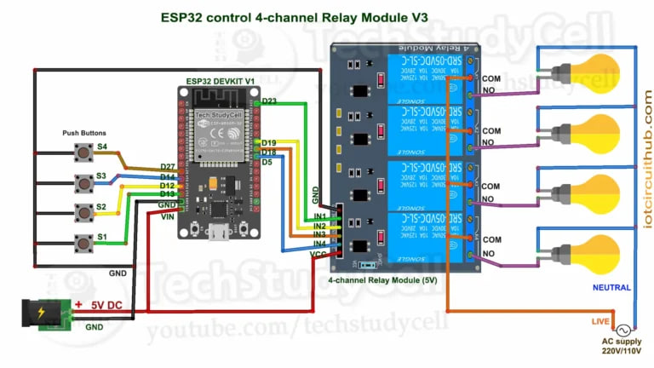
Circuit Diagram:

Slide 9
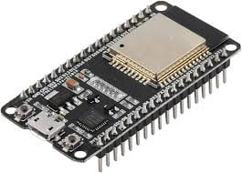
Components: ESP32
ESP32 is a powerful, low-cost, and energy-efficient microcontroller with built-in WiFi and Bluetooth capabilities. Developed by Espressif Systems, it is widely used in IoT, automation, and embedded systems due to its versatility and high performance.

Slide 10
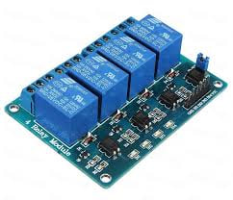
4-channel 5V SPDT Relay Module
A 4-Channel 5V SPDT (Single Pole Double Throw) Relay Module is an electronic switch used to control high-power electrical devices using a low-voltage microcontroller like ESP32, Arduino, or Raspberry Pi. It allows safe isolation between the control circuit and high-voltage loads.

Slide 11
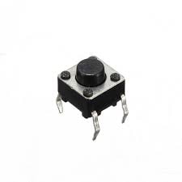
Push button:
A push button is a switch that controls circuits by
making or breaking connections when pressed.
It has NO, NC, and COM terminals. A
2-pin button connects to GPIO and GND.
Used in home automation, IoT, and embedded
systems for manual control.

Slide 12

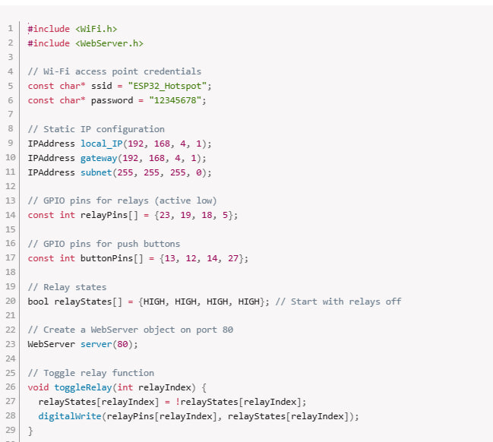
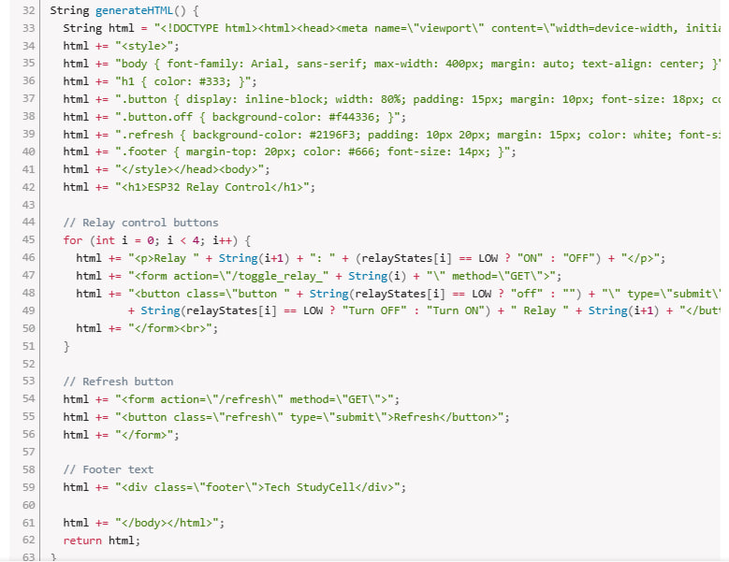



Code:

Slide 13


Slide 14
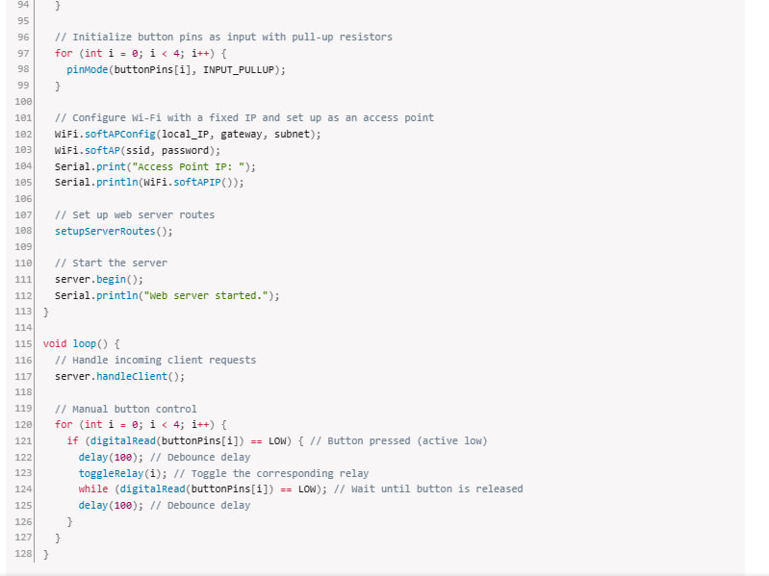

Slide 15
Applications: Remote Control – Operate lights, fans, and appliances via the Blynk app. Energy Saving – Schedule and automate devices to reduce power consumption. Security – Motion sensors, cameras, and alerts for intruder detection. Fire & Gas Detection – Smoke/gas sensors trigger alarms and notifications. Voice Control – Integrate with Google Assistant or Alexa for hands-free operation. Smart Lighting – Adjust brightness and colors remotely .

Slide 16
Advantages:
Remote Control – Operate home appliances from anywhere using the Blynk app. Energy Efficiency – Automates devices to reduce unnecessary power consumption. Enhanced Security – Motion sensors, cameras, and real-time alerts improve safety. Dual Control Mode – Supports both manual switches and app-based control. Easy Integration – Works with voice assistants like Alexa & Google Assistant. Cost-Effective – Uses ESP32, which is affordable and feature-rich. Scalability – Can add more sensors and devices as needed.

Slide 17
Disadvantages : Internet Dependency – Some functions require a stable WiFi connection. Security Risks – Smart systems are vulnerable to hacking if not secured properly. Initial Setup Complexity – Requires programming and hardware setup knowledge. Power Failure Issues – Needs a backup power source for uninterrupted operation. App Reliability – Blynk server downtime can affect remote access.

Slide 18
Conclusion:
Smart Home Automation using Blynk & ESP32 provides an efficient, cost-effective, and scalable solution for controlling home appliances remotely. With features like WiFi & manual control, energy savings, security enhancements, and voice integration, it enhances convenience and safety. However, challenges like internet dependency, security risks, and setup complexity must be considered. Despite these limitations, the system offers a modern, flexible, and customizable approach to home automation, making it an excellent choice for smart living.

